Slide 1
^{DSI Capstone} ^{10/24 Weekly Update}
Oct 27, 2022

Slide 2
Agenda
1
From Last Week
2
Modeling Deep Dive: Generalization
3
Optimization - Forming the Model
4
Next Steps

Slide 3
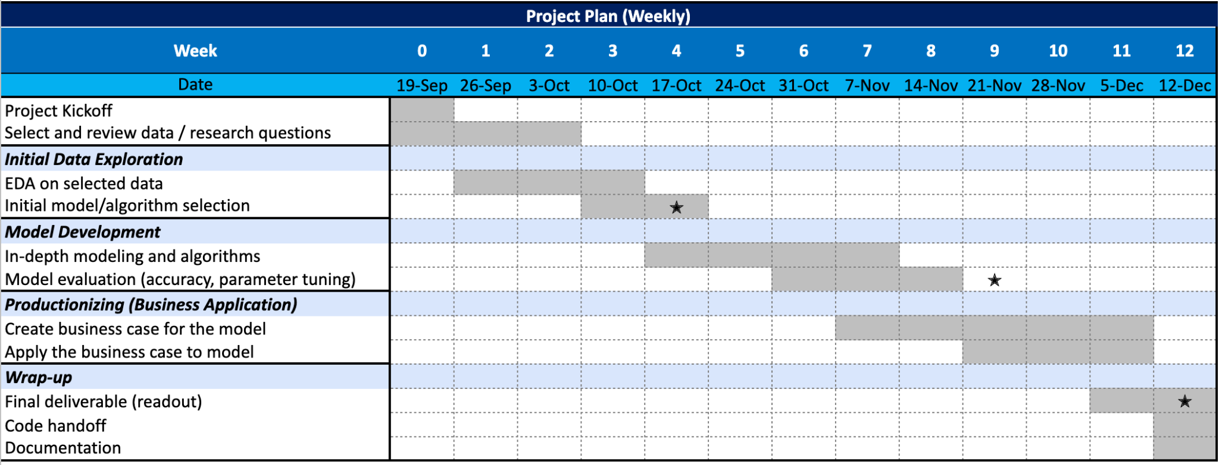
From Last Week: Timeline
1
1st progress report

Slide 4
From Last Week
1
Action items:
Classification: fine-tune the model & try to see if model applicable in other area
Optimization: improve objective function to consider cost and traffic count per charger
Generalization (Transfer Learning): address data imbalance issue

Slide 5
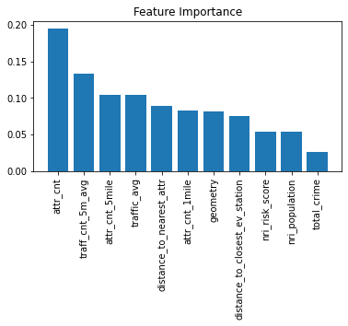
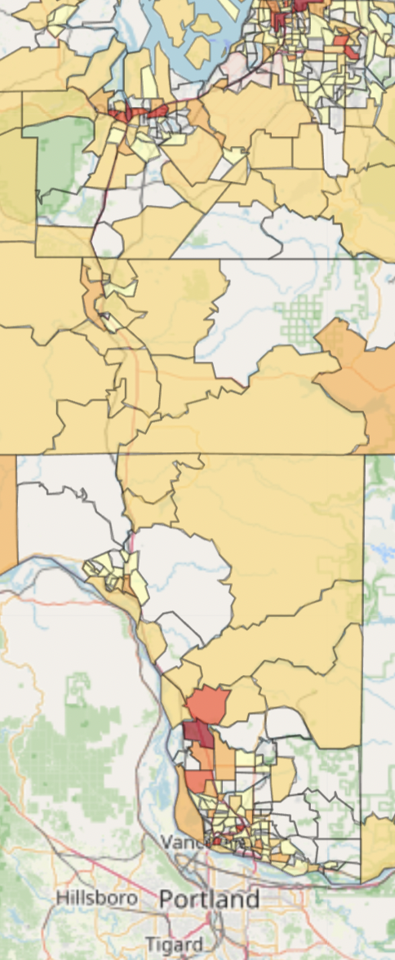
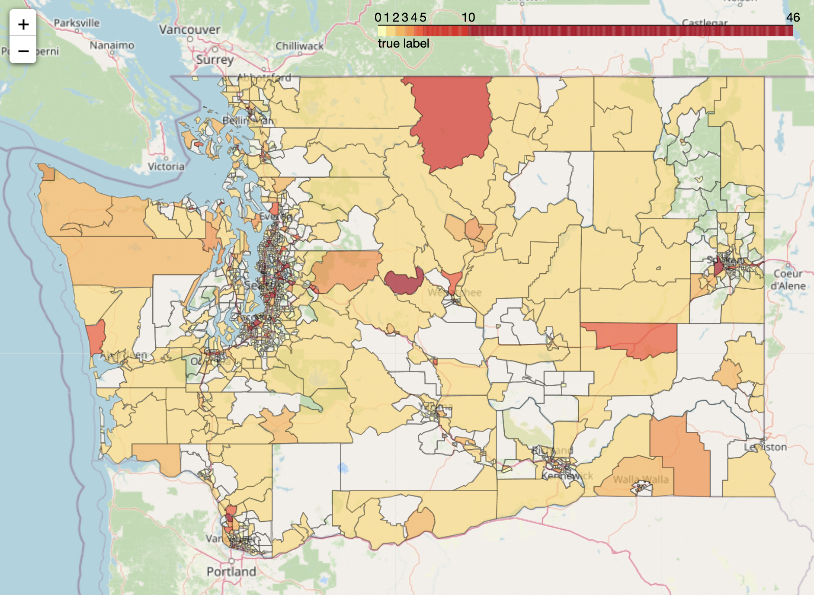
Modeling Deep Dive: Generalization
2
The model is trained and validate on census tracts with existed EV stations or labeled as ‘urban’. Best model results after randomized search with cross validation:
training MSE: 1.151, validate MSE: 0.941
training r-squared: 0.886, validate r-squared: 0.885
11 out of 35 features were selected. Highly correlated and unuseful features are removed.
The number of attractions is the most important feature, followed by average daily traffic in the area.
Notes:
Last week, we assumed that the number of EV stations in urban area is optimal. However, the model predicted mostly zeros. Hence this week, we also include rural census tracts with existed EV stations. The model is now trained and validated on census tracts with existed EV stations or labeled as ‘urban’. Best model results after randomized search with cross validation is shown here. We selected 11 features out of 35, and number of attractions is still the most important feature.
There are some empty areas in the graph. These are the census tracts lacking gas stations. Since our data points are generated by each gas station, the model are not able to make predictions in those area.

Slide 6
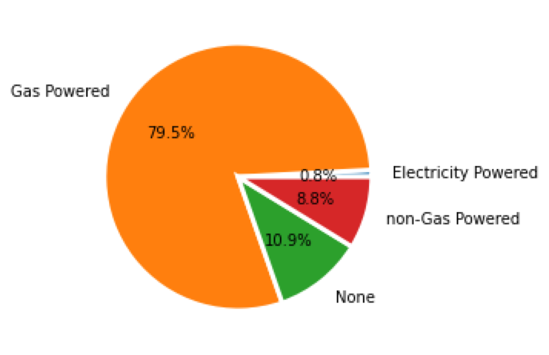
Modeling Deep Dive: Optimization
3
Goal: Incorporate demand constraints (traffic coverage of each gas stations) into the optimization model to make the model perform better
Assumption
Assume in Seattle city areas the EV stations supply is enough for covering EV traffics
Average EV traffic coverage per station within 2 miles:
236
Metric
For each exit (a total of 23 exists) on I-5 in Seattle city area
calculate the maximum of annual average daily traffic count within 2 miles and the number of EV stations within 2 miles
total traffic ratio = traffic count within 2 miles / # of EV stations within 2 miles
take the average of each ratio on exits and come to the final ratio
To approximate the EV traffic,
we multiply the total traffic by 2%
From the pie chart, EV account for
0.8% of all registered vehicles
Assume EV market growth,
we considered 2%
Notes:
Assume in seattle city areas the EV stations supply is enough for covering EV traffics:
for each exits on I-5 in Seattle area, calculate the traffic count within x miles & # of stations within x miles
total traffic ratio = traffic count within x miles / # of stations within x miles
take the average of each ratio on exits and come to the final ratio
Estimate EV traffic: take 2% based on bar chart: 0.8% EV powered cars but we expect growth
23 exits; within 2 miles station: 236; within 5 miles station 34 daily

Slide 7
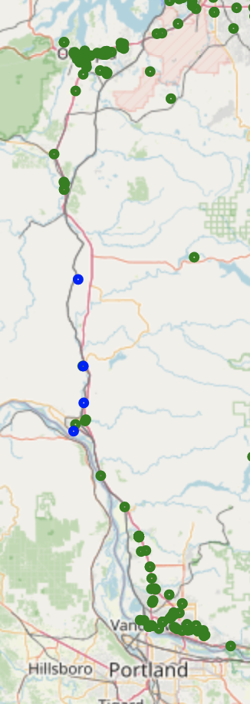
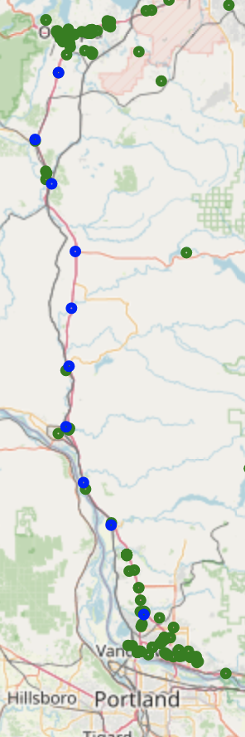
Modeling Deep Dive: Optimization
3
Objective function
Maximize traffic count covered
Constraints
Distance to highway exit < 1 miles
# of EV stations within 2 mile distance < 3
# of EV stations within 20 mile distance < 10
NRI risk rating is not Very High
New proposed locations are at least 5 miles apart
Objective function
Minimize new charging stations count
Constraints
Distance to highway exit < 1 miles
NRI risk rating is not Very High
Supply not exceeding demand (Current EV station cnt * ratio <= EV traffic cnt)
All demand satisfied (New EV station cnt * ratio >= EV traffic cnt)
: Existing EV charging location
: Suggested EV charging location
Notes:
changed objective function from maximize traffic to minimize charging stations & incorporated demand & supply situation into our model
IMPROVEMENT: make the results more reasonable
original: before we take demand into account
optimized location won’t be placed within 20 miles from the city because of the # constraint (already enough # of chargers) but not reasonable because city demand might be larger than rural area so there may be demands for more chargers
rural areas with lower traffic access may already have enough stations but our model may place some extra stations there based on the constraints
new:
(upper circle in the graph) - adjust the optimal location by traffic count so some are close to cities

Slide 8
Next Steps
4
Action items:
Apply the current brute-forced optimization model onto pyomo for faster solvers and see modeling results
Transfer data into useful format
Formulate objective functions and constraints on pyomo
Download and apply Groubi solver
Notes:
Ask midpoint readout for next week?

Slide 9
Appendix

Slide 10
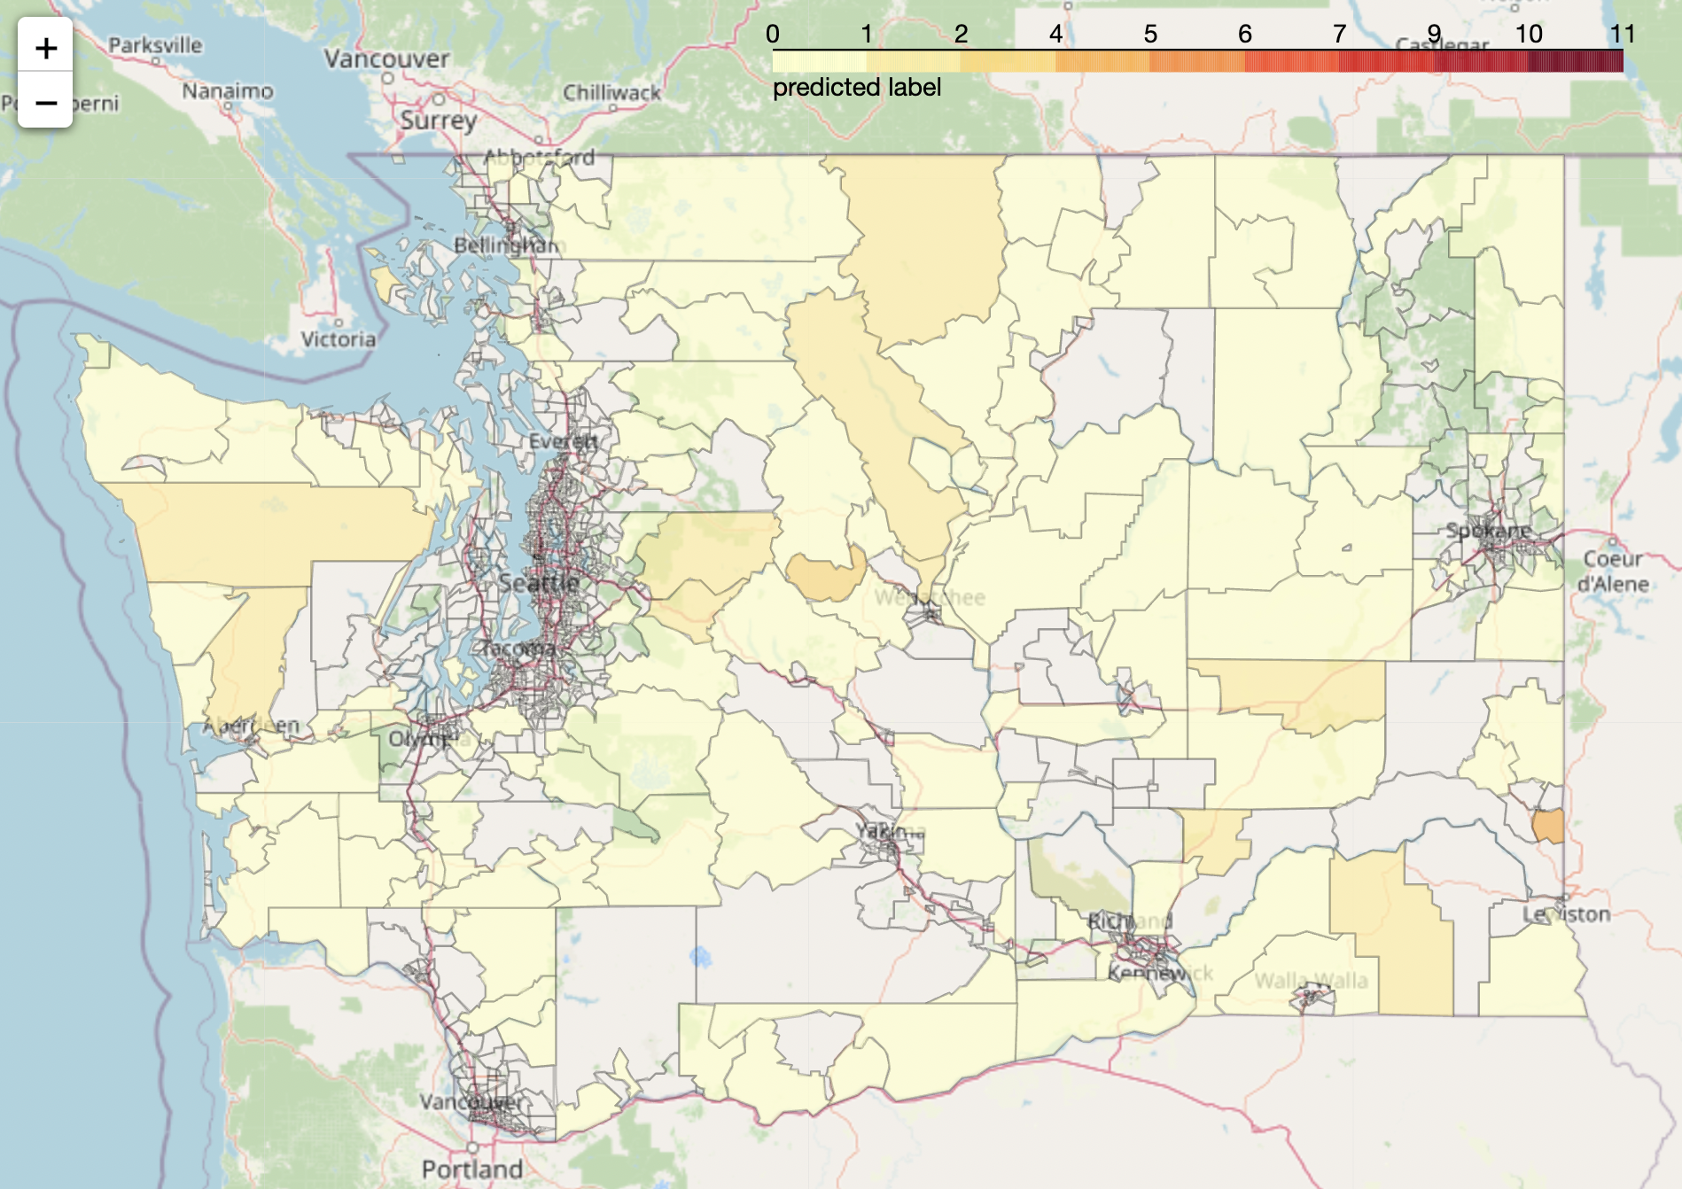
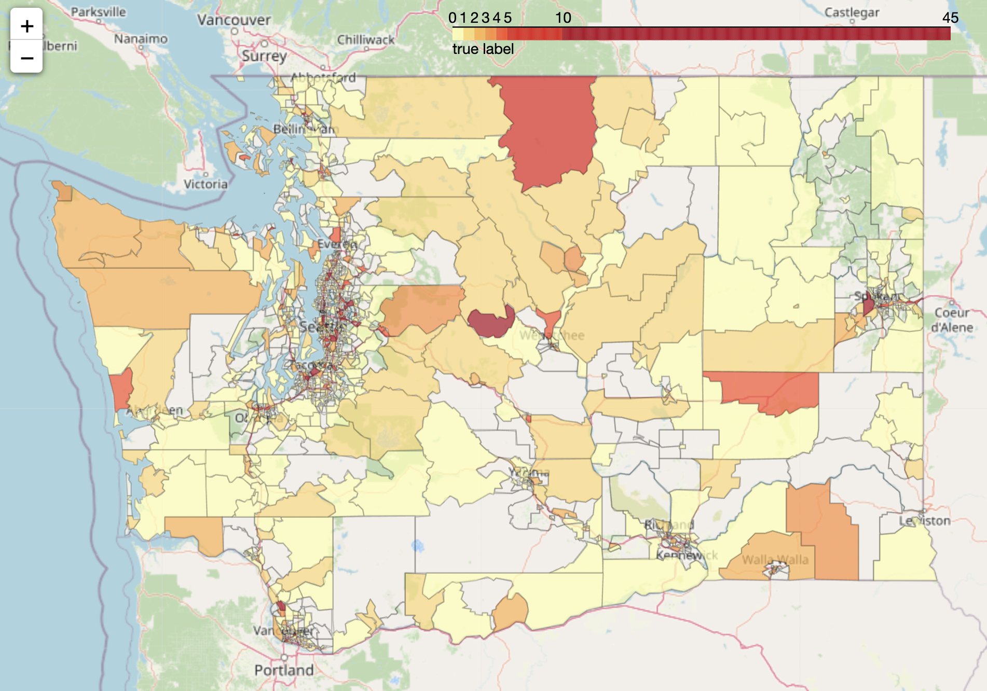
Previous model result & Current EV Station Distribution

Slide 11
